Slide 1

1st October 2025
Please register your attendance using the QR code below. You can add questions later if you wish.
Year 11 Parents’ Information Evening
Topics covered this evening:
Key staff, key dates, general revision, E/M/Sc information and revision, Post-16, opportunities, mental health.

Slide 2
Welcome from Mr West

Slide 3

Key Staff
If you need to contact someone about your child, the best person to speak to is their tutor in the first instance.
Mr A West Headteacher
Mr B Gilkes Progress leader Year 11
Ms Down Progress Manager
Ms S Butler Director of English
Ms S Atkey Director of Mathematics
Dr R Marsh Director of Science
Mr S Payne Tutor to 11XT Mr A Hall Tutor to 11YT Ms A Thornton Tutor to 11XO
Mr E Duckham Tutor to 11YO Ms S Buttler Mr S Sims Tutor to 11XS Ms R Arora Tutor to 11YS

Slide 4
Key dates
W/B | Important events
2nd October | Year 11 prefects announced
14th October | Year 11 revision day
10th November | Y11 pre-public exams begin
27th November | Sixth form open evening
18th December | Year 11 parents evening
9th January | Year 11 Visual Arts NEA Deadline
5th February | Y11 pre-public exams (2) begin
20th April VA 8th May others | GCSE Exams begin (date depends on exam)
26th June | Year 11 leaver’s day and prom
20th August | GCSE results day

Slide 5
Revision strategies
How to Study effectively

Slide 6





PACE IT OUT
IX IT UP
NALYSE your weaknesses
EVISE AND REVIEW
EST YOURSELF

Slide 7
Revision resources
John Mason School revision website includes exam FAQ and period 6 timetable
Seneca
BBC Bitesize
Past exam paper questions e.g. Physics and Maths Tutor
Revision guides - ask the teacher for the best options
Flashcards (physical and online eg Quizlet)
Other online content – please check quality/relevance with your child’s teacher.

Slide 8
A team effort
Teachers
Plan and teach great lessons
Feedback on past papers
Pre-public exams with detailed feedback
Exam technique and training
Support and guidance
High expectations
Students
Waste no time
Revise effectively (if it's not a struggle, it's not working)
Make a plan you can stick to
Don't take on too much
Ask a teacher
Attend period 6 sessions
Parents
Questioning
Quiet space to revise
Emotional support
Encouragement
Blend of activities
Sleep
Snacks and drinks

Slide 9

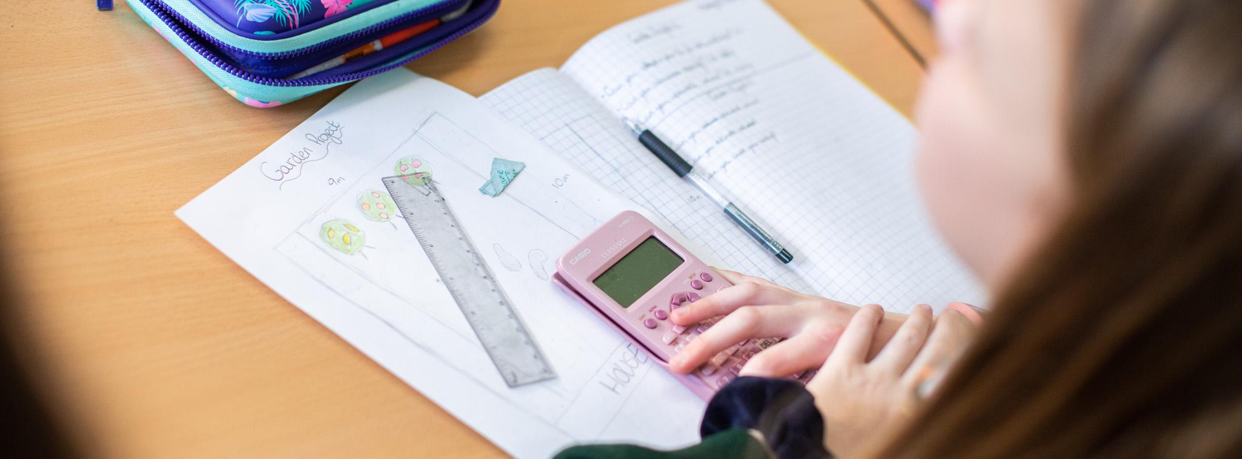
GCSE Mathematics
Ms Atkey - Director of Maths

Slide 10
Mathematics (Pearson Edexcel 1MA1)
Key Points
100% exam
3 exams (each 1hr 30mins long) equally weighted
1 non-calculator paper
2 calculator* papers
Two tiers of entry (Higher: grades 4-9 & Foundation: grades 1-5)
The papers overlap, with the same grade 4/5 questions appearing on the Higher and Foundation paper
Sets 1-3 currently focusing on Higher
Sets 4-6 currently focusing on Foundation
Tiers not decided until April 2026

Slide 11
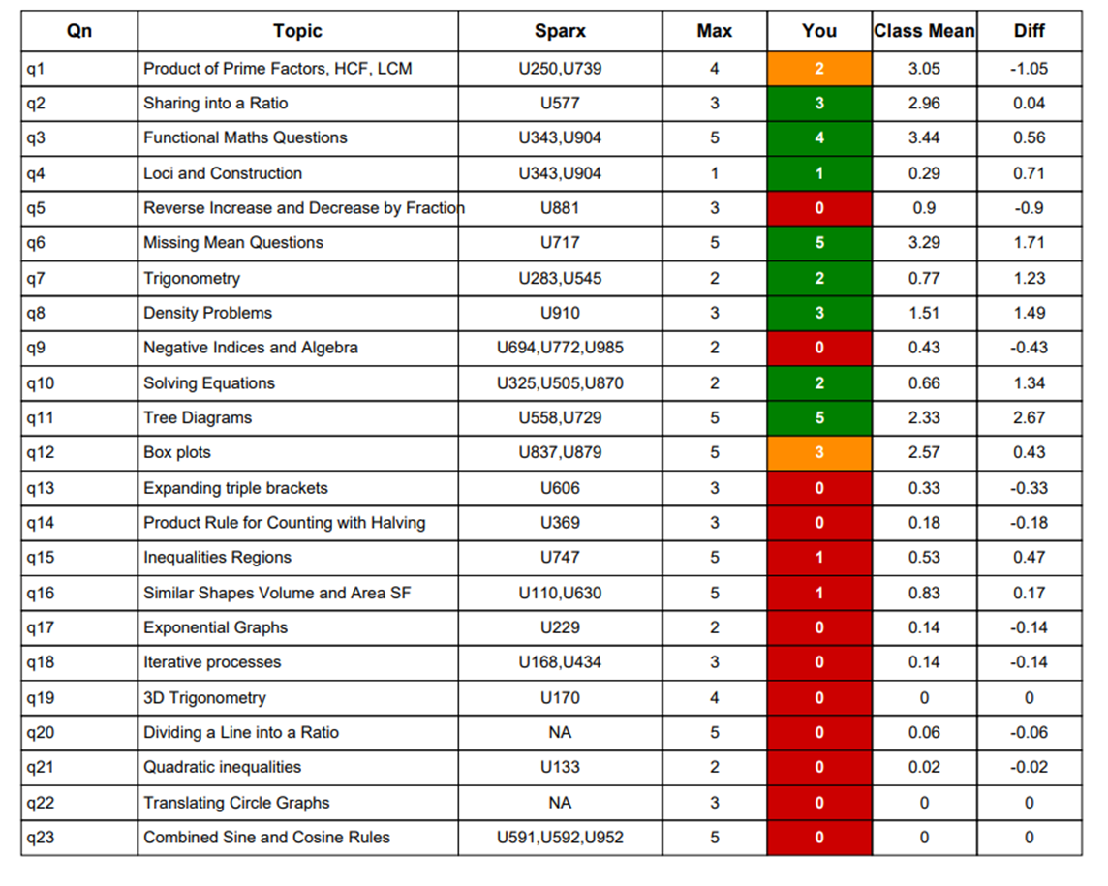
Mathematics
How to revise (Little and often)
Maths is a practical subject; you need to practice the skills and be able to the apply knowledge to solve a range of problems
Making full use of lessons (Period 1: attendance is key!)
Weekly practise on Sparx (30 mins HW)
Weekly past paper practice (half a paper per week)
Be confident in non-calculator arithmetic
Use assessment feedback to plan revision

Slide 12
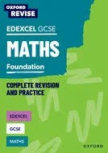
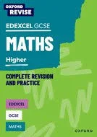
Useful resources to help revise Maths
Websites:
MathsGenie: full of past papers, mark schemes, model answers and tutorial videos
Corbett Maths: Tutorial videos on topic, with worksheets and exam questions to practice
1st Class Maths: Loads of revision resources, videos, past papers
Sparx: thousands of questions to consolidate knowledge and understanding
Other resources:
Your Maths teacher!
Thursday period 6 every week
Tutor time resources
Revision guides

Slide 13
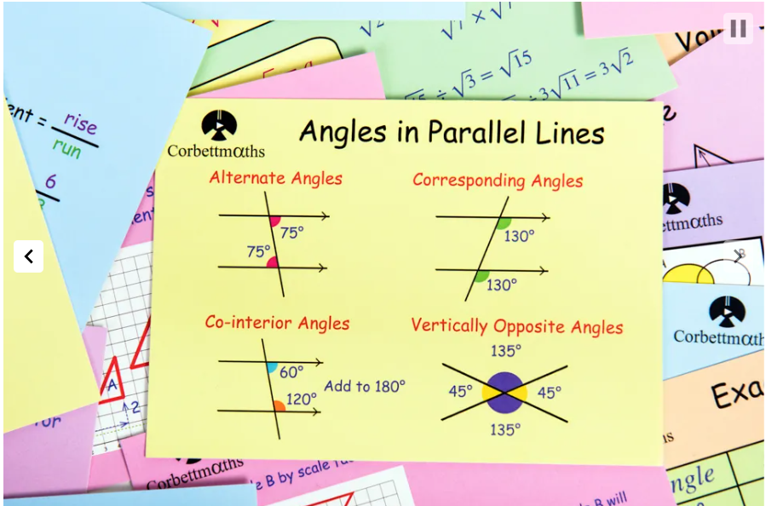
Corbett Maths Revision cards

Slide 14
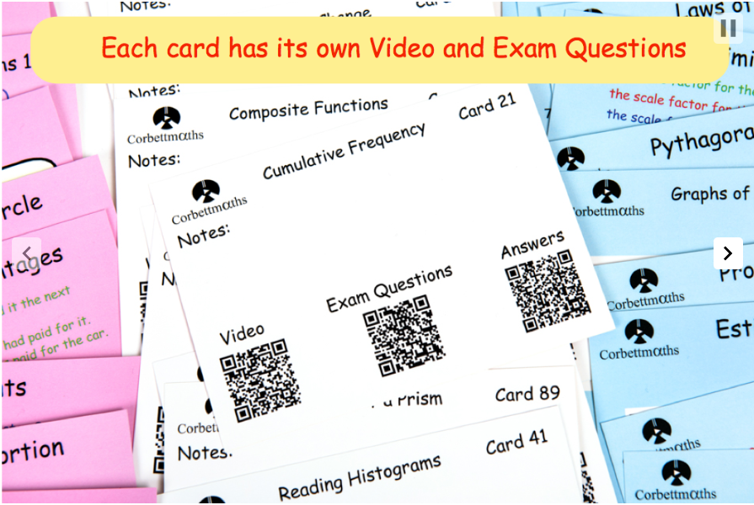

Slide 15
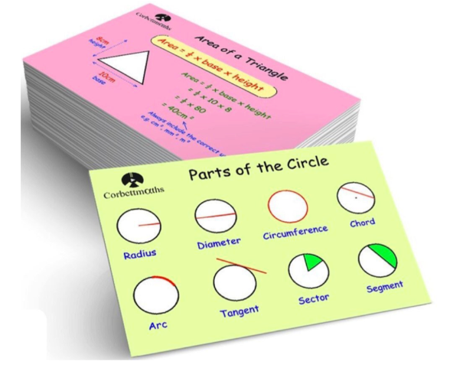
Sort your cards into three categories
Very confident on that topic
Have some idea but not confident
Not got a clue!

Slide 16
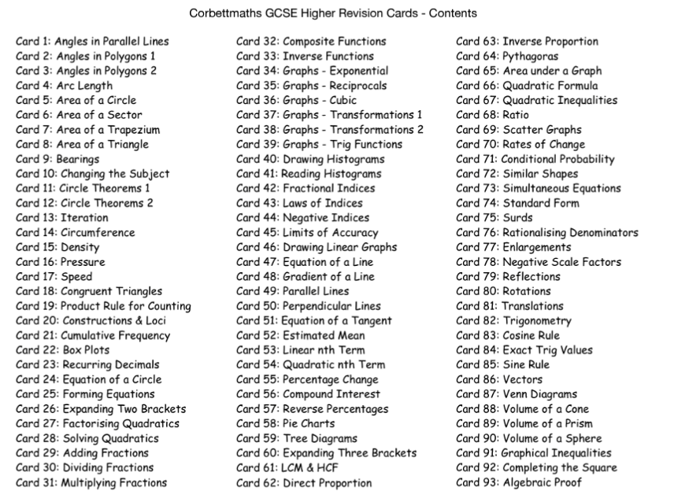

Slide 17
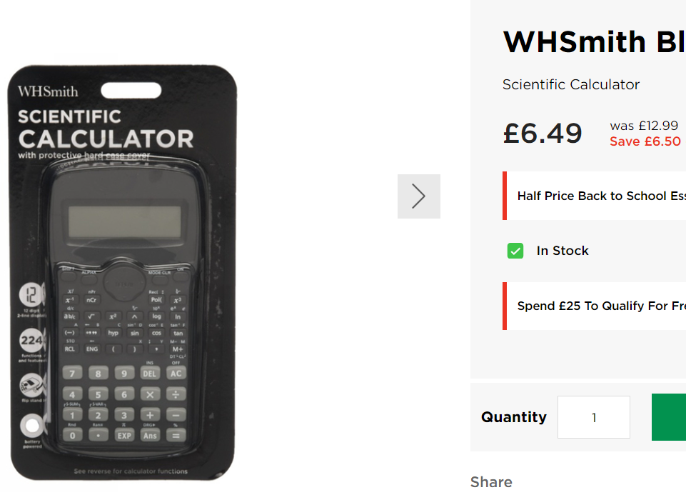
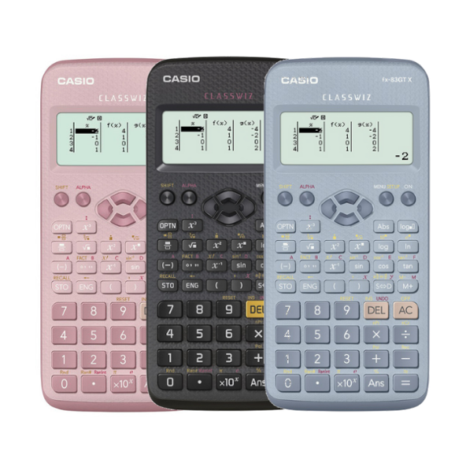
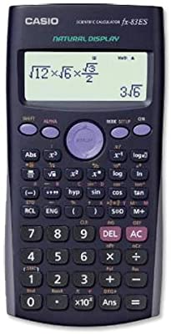
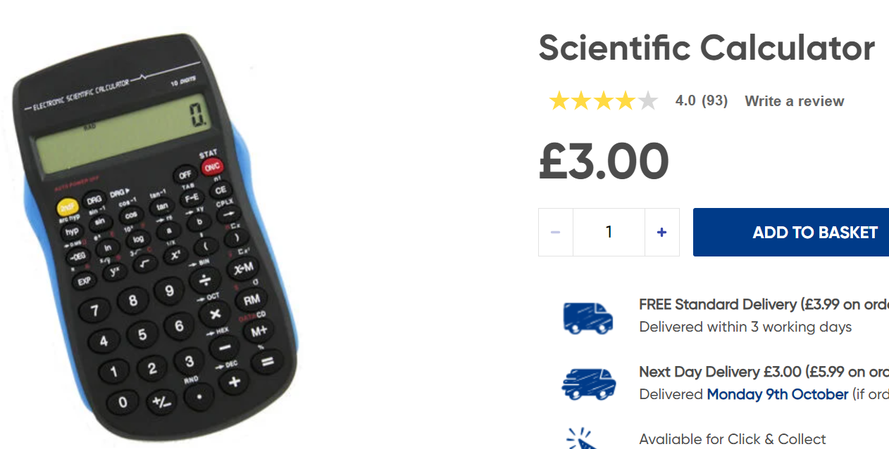
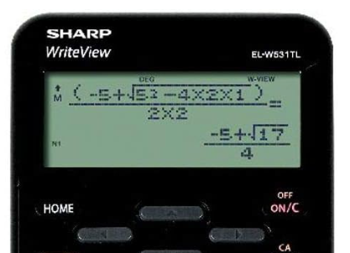
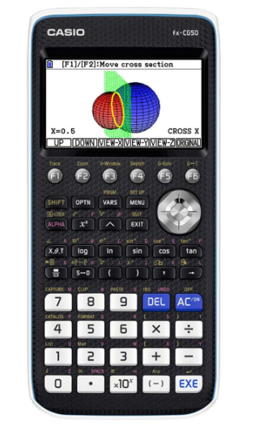
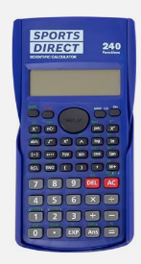

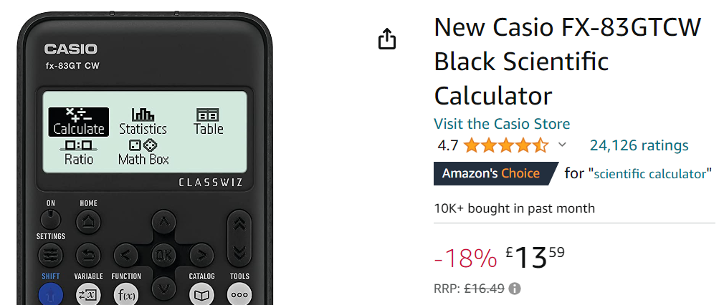
Not all scientific calculators are created equally
Can be purashed on MCAS and collected from reception
Recommended!
Avoid!

Slide 18
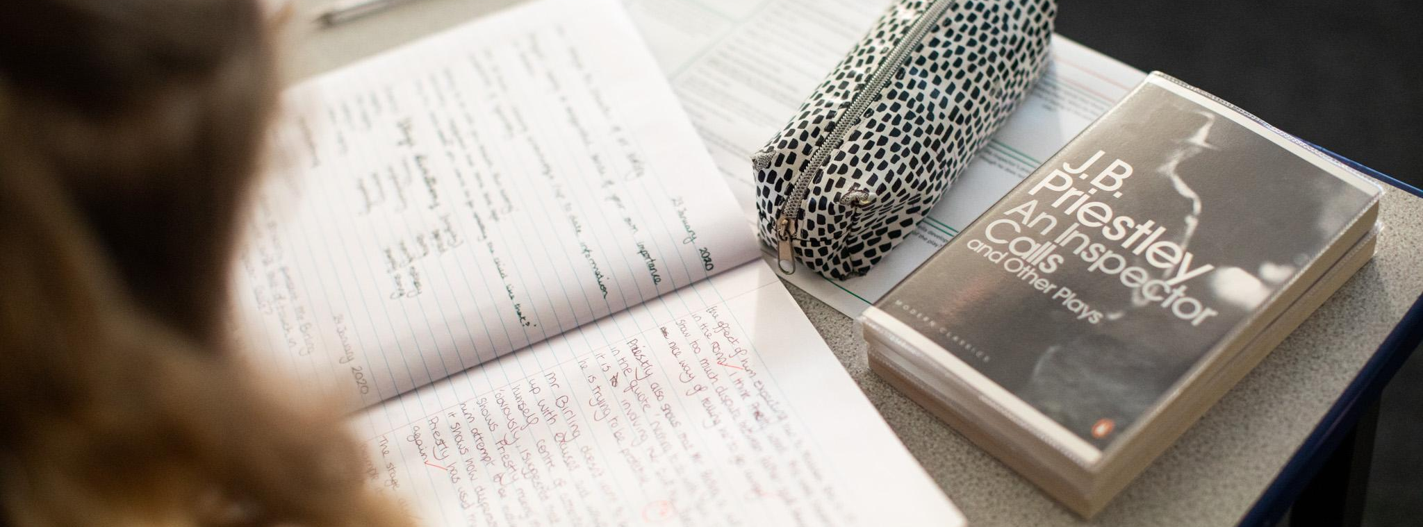
GCSE English & GCSE English Literature
Ms Butler - Director of English, Associate Senior Leader

Slide 19
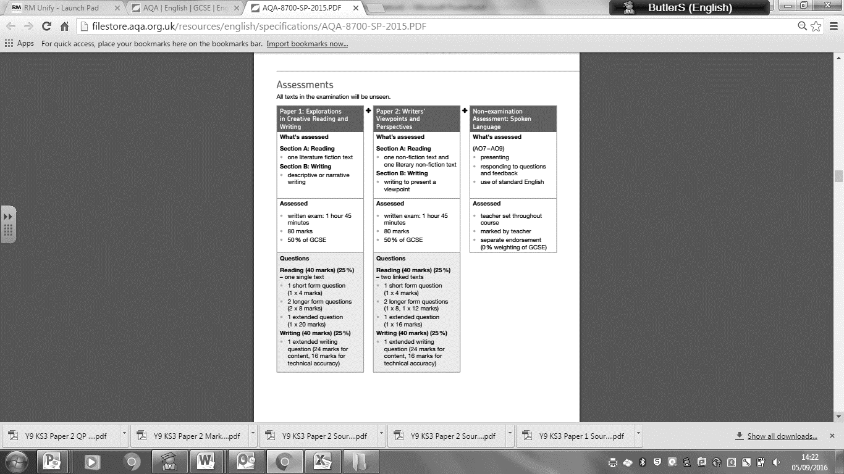
English Language (AQA 8700)
Key Points
100% exam
2 papers equally weighted
Writing and reading equally weighted
SPaG worth 20%
(Spelling, Punctuation and Grammar)
How to revise
Understand the demands of each question and know how to answer it e.g. Q2 = PQME
Revise language and structural methods in order to be able to identify these and comment on them
Practice applying that understanding using past papers

Slide 20




English Literature (AQA 8702)

Slide 21
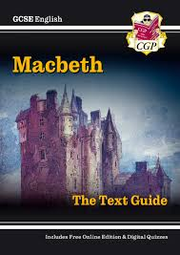

Useful resources to help revise English
Websites:
Mr Bruff revision videos including character and theme tutorials and analysis of grade 9 essays. Also useful for English Language https://www.youtube.com/@mrbruff
Massolit - videos by academics on literature texts https://massolit.io/
Username = email
Password = Massolit
Other resources:
Quotation booklets from y10
CGP revision guides
Tuesday Period 6 in E4
Your English teacher!

Slide 22
How to revise English Literature
Make sure you know what topics you need to revise and RAG them
Macbeth Guilt
Lady Macbeth Ambition
Banquo Appearance vs reality
Duncan Violence
Witches Kingship / power
Essay questions are fairly straight forward references to these
How does Shakespeare presents ideas about…
How far does Shakespeare present X as __________....

Slide 23
How to revise English Literature
Write down what you know already as a mindmap
Do some additional research and adjust your mindmap (add and check)
Watch Mr Bruff / Massolit
Read essays we have read in class / notes in exercise books /booklets
3. Turn your mindmap into an essay plan
4. Write up an essay / paragraph

Slide 24
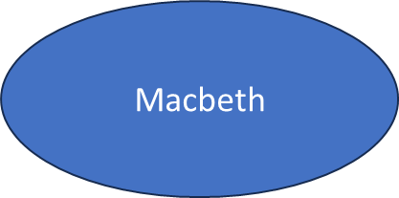
1. Begins the play as a warrior in King Duncan’s army, fighting for _______________
2. Hears a _____________ from 3 witches which states that he will become ____________ of Cawdor and later _____________
Macbeth
5. Killed by Malcolm which restores order to Scotland.
3. Macbeth is persuaded by _________ to kill _____________ ____________________
4. Begins to hallucinate e.g_________________
Becomes more violent e.g. ___________________

Slide 25
Character Analysis: Macbeth (youtube.com)
Macbeth is a tragic hero
highly renowned
Reversal of fortune
Fatal flaw
1. Begins the play as a warrior in King Duncan’s army, fighting for Scotland
Sergeant tells Duncan about “brave Macbeth”
2. Hears a prophesy from 3 witches which states that he will become Thane of Cawdor and later King
Macduff
Macbeth
5. Killed by Malcolm which restores order to Scotland.
“I’’ll fight till from my bones the flesh be hacked” – The bravest moment of all? (cyclical)
3. Macbeth is persuaded by his wife to kill King Duncan
4. Begins to hallucinate e.g a dagger / the ghost of Banquo
Becomes more violent e.g. kills Banquo / the MacDuff children and their mother
Not shown on stage – support sympathy for Macbeth “I am afraid to look on what I have done”

Slide 26
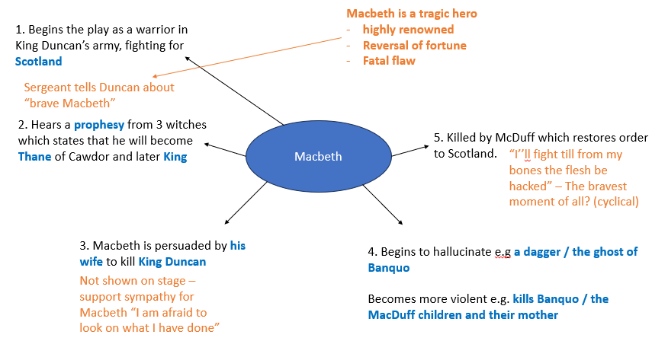
How far is Macbeth presented as brave?
Bravery is link to violence at the start –tragic hero
Ambition causes cowardly regicide -not brave to murder Duncan in his sleep
As King his violence is out of desperation / fear not bravery
At the end on the battlefield he is again shown as brave (re-enforcing the Great chain of Being)

Slide 27
How far is Macbeth presented as brave?
Shakespeare presents Macbeth as brave.
Shakespeare introduces Macbeth as bravely fighting for his King and country.
Shakespeare introduces Macbeth as a patriotic warrior whose exceptional bravery was noticed by others and deserving of attention from the King. Before we meet Macbeth, we hear from the sergeant of how “brave Macbeth” faced the enemy and led Scotland to victory which immediately establishes Macbeth as highly renowned and worthy of respect…

Slide 28

GCSE Science
Dr Marsh - Director of Science

Slide 29

Science
Key Points
AQA
Three GCSE subjects – Biology, Chemistry, Physics
Two exam papers per subject – 1hr 45 mins, 100 marks.
6 exams in total
Higher Tier and Foundation Tier
Revision guide
Homework - Carousel
Core Questions
Read, Cover, Test, Check
Lessons
Seneca
Physics and Maths Tutor .com

Slide 30
Science
We need your help!
Revision guide
Core Questions
Read, cover, test, check
Nov Mock
Feb Mock
End of topic tests

Slide 31
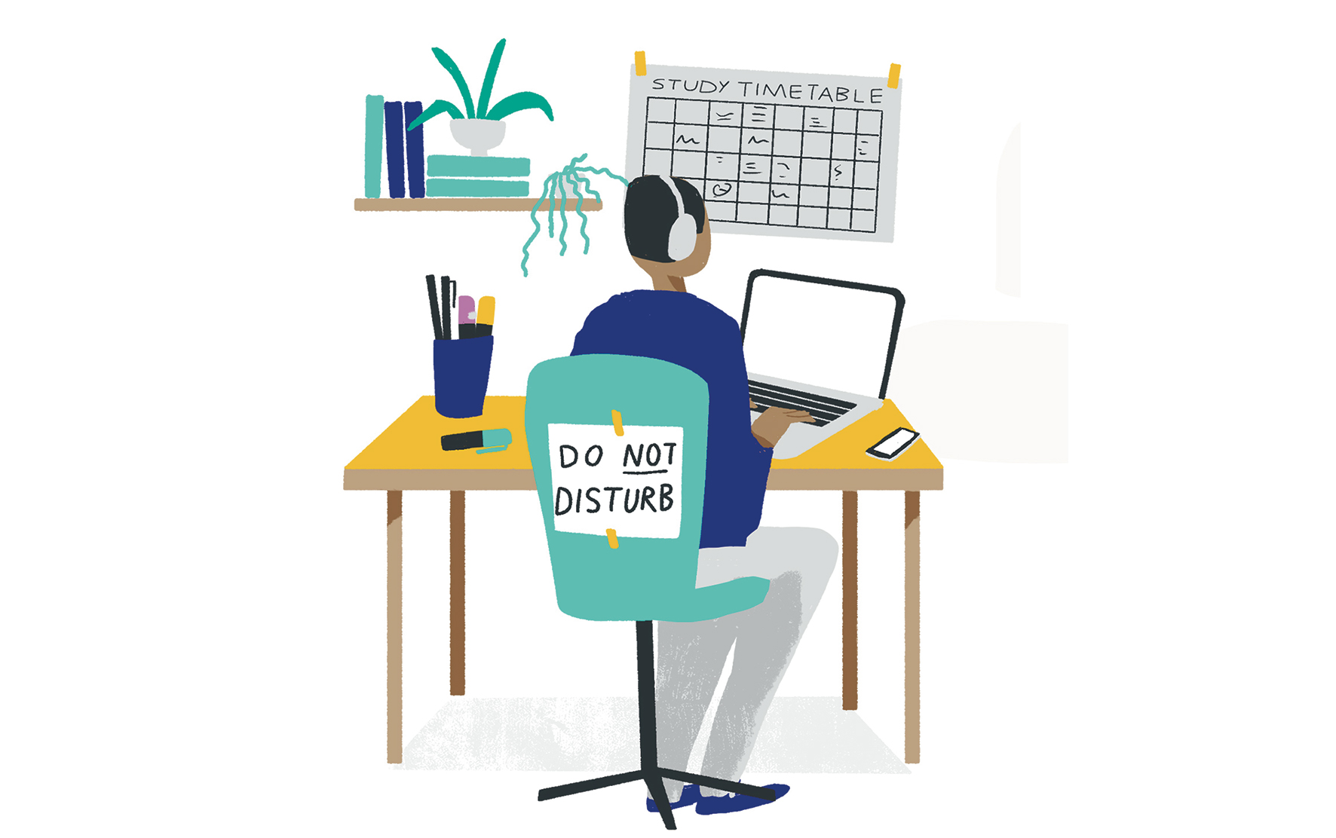
Mental health, Attendance, opportunities and recognition.
Mr Gilkes- Director of KS4

Slide 32
Natalie Hunt – A mentally healthy approach to exams
https://drive.google.com/file/d/1j0PLEzIbsi9zVbjpGzBRPnReNUVR5lwD/view?usp=drive_link

Slide 33

Mental Health & Wellbeing
For All:
Embedded within Personal Development sessions
Assemblies - CAMHS and NH.
Tutors/pastoral team
Online resources
Referred:
Exam stress groups.
School Counsellor.
CAMHS in reach groups.
Other external agencies
NHS - 5 Ways to Wellbeing:

Slide 34
Impact of attendance
150 days before year 11 exams.
17+ days absent 🡪 Did not achieve 9-4 E/M.
<5 days absent 🡪 Did achieve 9-4 E/M
84% of students with full attendance 🡪 9-4 in E/M.
35% for students who were PA 🡪 9-4 in E/M.
Students who increased their attendance by 5 % (8 days) were twice as likely to pass GCSE English and Maths (DfE 2024)
A high attendance leads to a greater chance of success for most people
Increased contact, recognition and support for good attendance throughout the year.
Please see the attendance guide on the school website for more information.
https://explore-education-statistics.service.gov.uk/find-statistics/the-link-between-absence-and-attainment-at-ks2-and-ks4

Slide 35
Careers advice
Careers advisor interviews
Personal Development curriculum.
Apprenticeship workshops
Mock interviews
Abingdon and Witney college

Slide 36
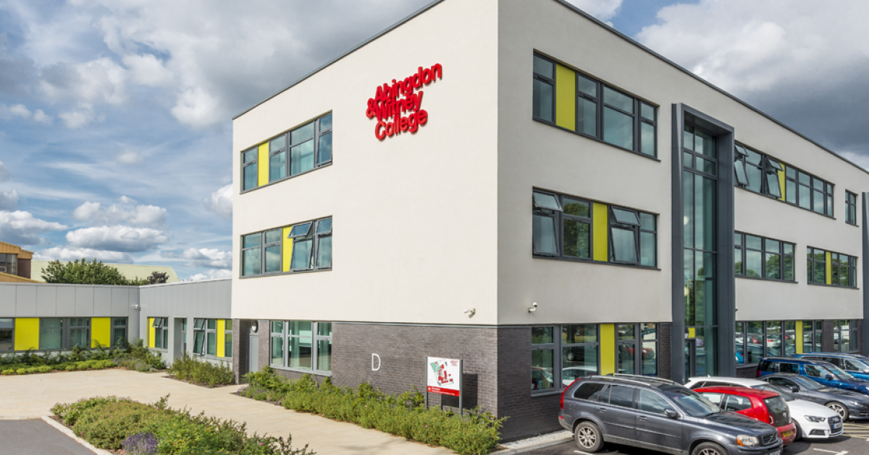
Abingdon and Witney College
Go to their website for course information and entry requirements
Regular open days advertised online
Assemblies from AWC staff

Slide 37

Sixth Form Overview – JMF6
Joint sixth form
Approx. 40% of students stay on after Year 11 for JMF6
Joint provision with FHS – offering a wide breadth of A Levels.
Majority progress to undergraduate study, including Oxbridge & Medicine
Others secure high-quality apprenticeships.
Entry Requirements: Grade 5 at GCSE in the subject or nearest relative subject.
Full details available on the website. https://www.jmf6.org

Slide 38


OX14 opportunities
Sporting activities
Natalie Hunt wellbeing sessions.
MUN (Model United Nations)
Peer Support Leads
Academic mentoring
Oxbridge group
Lecture & performance invites.
OX14 Biology Magazine
Environmental group
Astronomy GCSE
Rugby coaching course
Free Yoga sessions

Slide 39
Passport to Prom
Friday 26th June
Sudbury House Hotel, Faringdon
An inclusive programme designed to support student motivation and celebrate their progress.
It helps students feel they’ve earned their place at the Prom through positive engagement with school life.
Students work towards their invitation by meeting a range of personal and school-based goals.
These are designed to be achievable and meaningful, encouraging effort, involvement, and growth.
This initiative builds confidence, resilience, and a sense of pride. It’s about recognising the journey, not just the destination—and we hope to see every Year 11 student celebrating together at the Prom.

Slide 40

Prefects
Application process
Involvement in student voice
Events in school

Slide 41
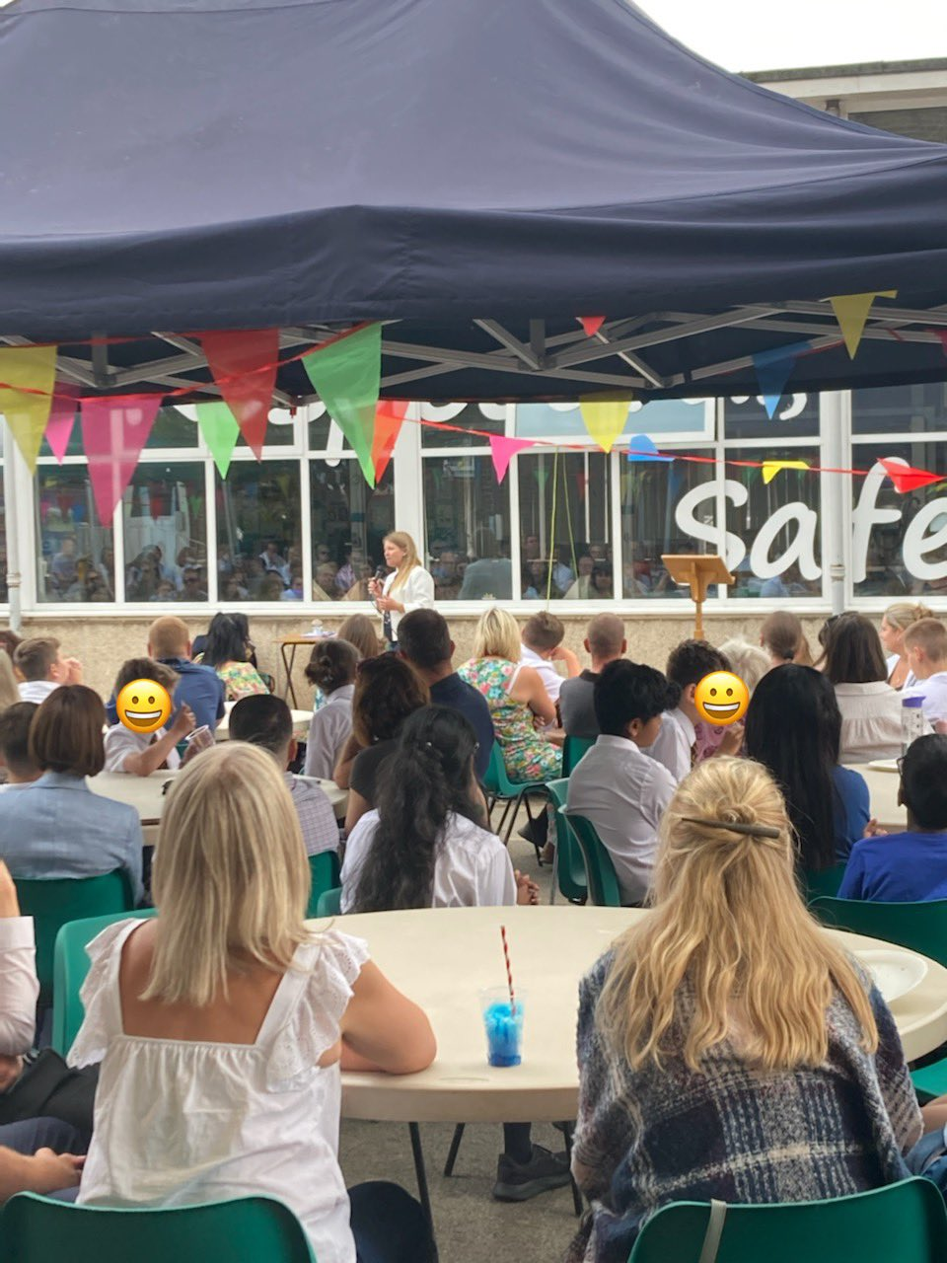
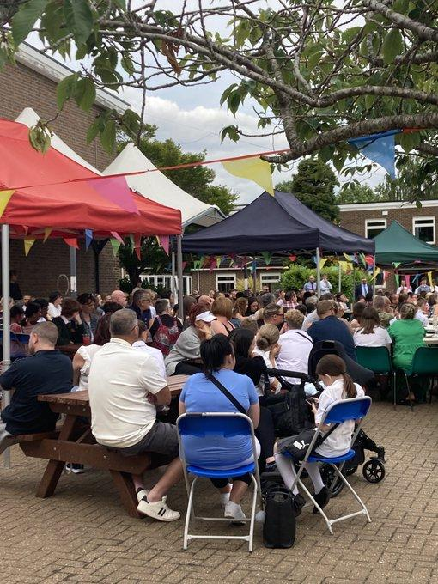
Celebration
Points awarded by members of staff and parents notified.
Regular messages to recognise students
Year group assemblies every week to recognise term
Whole school assemblies

Slide 42
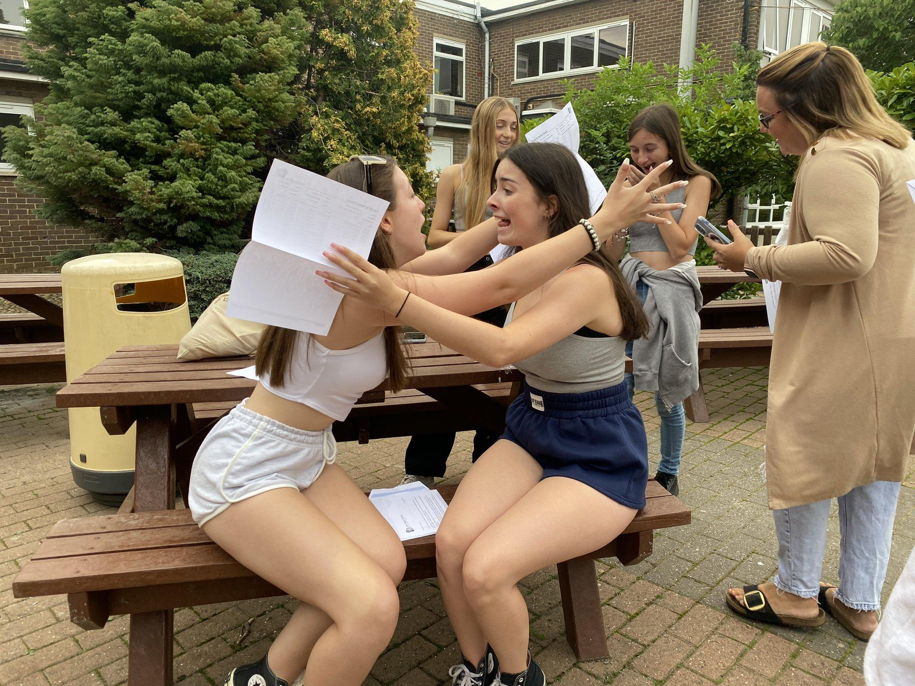
Please register your attendance and any questions using the QR code below
2025-26 will be a very successful year for all our JMS family.
Thank you for listening

Slide 43
Questions from PIE
I would like to know the date and time of any planned event for sixth form options and application process so I can ensure I will be available. Sixth form open evening on 18th December will have all the information pertaining to this and there will be more communications detailing the application process.
Are sets likely to change between now and the exams? It is unlikely for most students though some may change based on outcomes from the Pre-public exams.
When will silver D of E take place? We will be in touch when these dates are confirmed.
Typical number of hours study/homework at home the year 11 kids should do a week. There is no set amount of time, but it is recommended that they should spend 1-2 hours each evening studying.

