Slide 1

How to find a Work Experience Placement

Slide 2
Ask yourself the following Questions:
Do you have any idea what future careers you might be interested in pursuing?
If not, what school subjects, issues/current affairs or extracurricular activities are you interested in?
Do you have any contacts already that you can use? Think of relatives, family friends, parents of friends and people they may know – ask around.
Consider what we have locally: e.g. Harwell Science Campus, Milton Park business park
Consider towns outside of Didcot – Abingdon, Wallingford, Oxford, Reading. How would you get there?

Slide 3
Use the resources available to help you:
Unifrog (To be launched next term)
Watch the video A guide to placements / work experience (click on Know-how library and type Work Experience in the key word search box).
Use the Personality profile or Interests profile for ideas as to what might suit you.
Use the Careers Library to search for careers by key word or school subjects you enjoy.
Look at the Apprenticeships tab (under searching for opportunities) and search by subject/work area – this will give you contact details of employers who may be willing to offer work experience.
Look at Find Your Future from OxLEP https://the360expo.com/find-your-future/
eCLIPS https://www.eclips-online.co.uk/
Contact Terry Bianchini, careers adviser TerryBianchini@adviza.org.uk
Flick through local magazines and papers
Use Google or Google maps to search for employers in and around Abingdon, use social media or try https://www.yell.com/ or https://www.thomsonlocal.com/

Slide 4
Some ideas by sector:
Financial: banks, building societies, accountants, insurance companies, tax firms, finance departments of local companies
Art/design: galleries, museums, Cornerstone, architects, printing/branding companies, advertising, interior designers
Law: local solicitors, courts, Human Resources departments of local businesses
Engineering/construction/manufacturing: house building companies, architects, factories, Harwell campus, manufacturing companies
Healthcare/medicine: care homes, pharmacies/chemists, dentist, GP surgery, health clinics, St Johns Ambulance, Harwell campus, Oxford University, local hospitals, opticians, chiropractors etc.
Animals: vets, animal sanctuaries, stables, kennels, wildlife trust (BBOWT)
IT/Computing: app development companies, IT security companies, programming, RM, IT departments of local companies/schools
Media/books: radio stations, local newspapers or magazines, bookshops, libraries, publishers, Oxford University Press
Public services/admin: local council, estate agents, recruitment agencies, libraries, Human Resources departments
Education/children: primary and secondary schools, nurseries, sports clubs, adult education
Charities: local charities, charity shops, Citizens’ Advice, Didcot TRAIN, One Planet Abingdon Climate Emergency Centre
Science: Harwell campus, Culham Science Centre, UKAEA (Atomic Energy), science museums, water or energy companies, research departments
Leisure/tourism/hospitality: hotels, restaurants, cafes, leisure centres, sports clubs, Space Centre, cinemas, theatres, bookshops, libraries, museums, Earth Trust
Retail/sales: shops, supermarkets, garden centres, estate agents
Outdoors: landscape gardeners, Earth Trust, wildlife trust, sports clubs, archaeological services

Slide 5
Make a list of your top 5 ideal placements and start contacting them
If you do not have a contact name, the HR (Human Resources) department is usually a good place to start.
Give them a call or draft an email. Remember to be polite and sound interested in what they do.
If calling, plan what you want to say in advance and have a pen and paper ready to take notes.
You may need to send a CV or formal application if they ask you to.
Be aware that some sectors may not be able to take under 16s, and that some large organisations like UKAEA only offer work experience during their own fixed dates. Don't lose heart if the first companies you contact are not able to offer what you want.

Slide 6
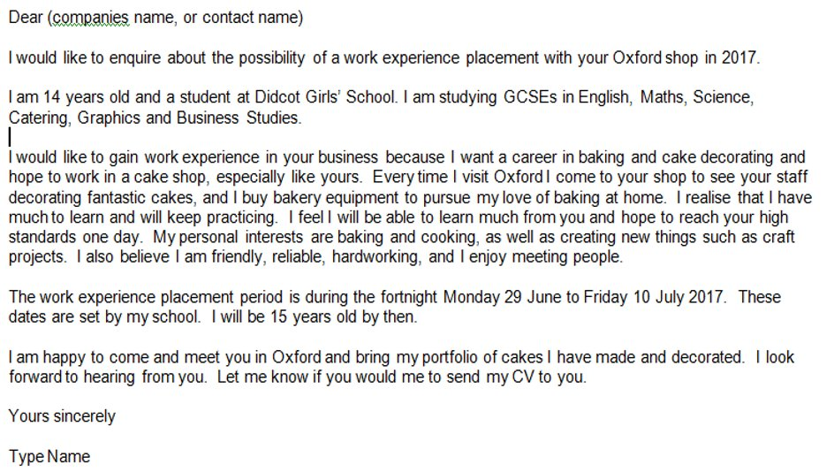
Example letter
This is a sample letter/email written to a prospective employer by a Year 10 student.
You can adapt it to suit your own style and interests.

