Slide 1

School Uniform – Inside & Outside the School Buildings

Slide 2
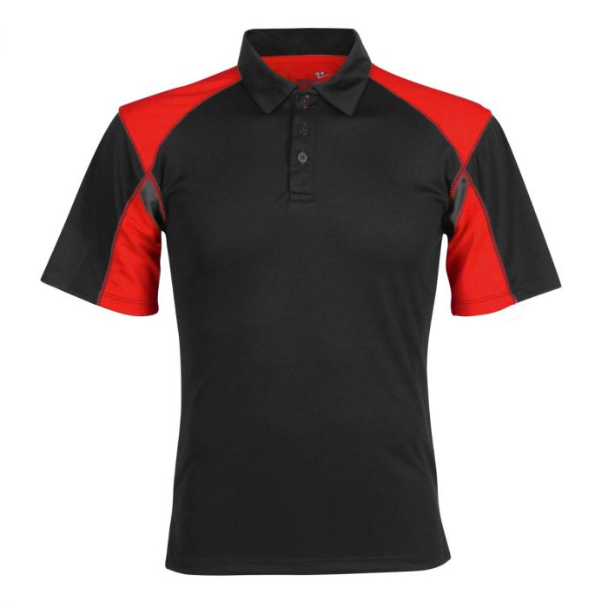
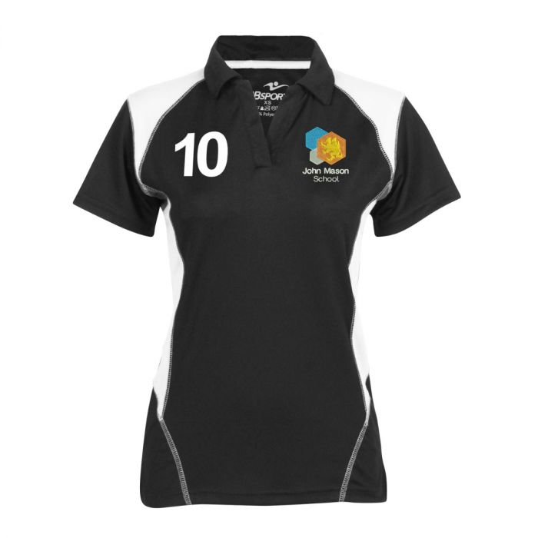
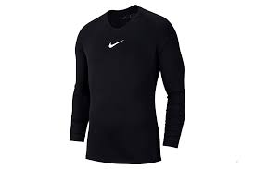
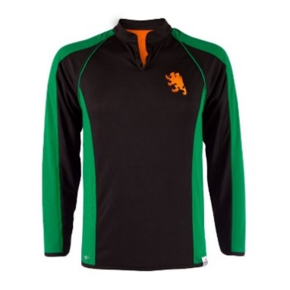
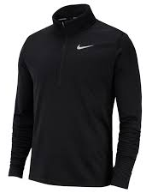

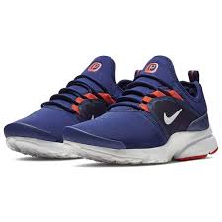
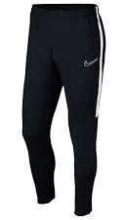
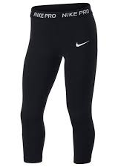
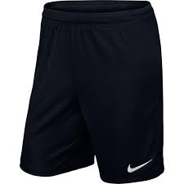
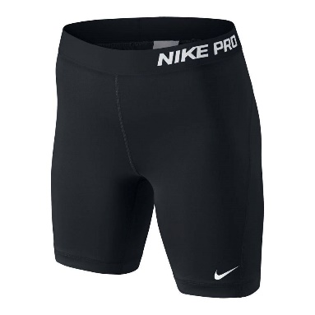
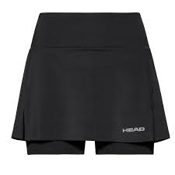
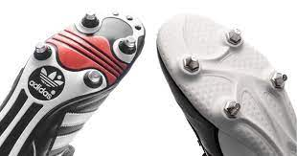

PE KIT – Guide to purchasing & policy
Top half - school house polo shirt or GCSE Polo shirt (From Year 10 )
if undertaking GCSE PE course.
Outdoor top - When weather is cold the school outdoor top with
buttons, or the school outdoor top with zip can be worn. Compression/thermal/skin tops can also be worn underneath these tops and the polo shirts.
House polo shirt
School outdoor top
with buttons
Compression /
Thermal top
School outdoor top
With zip
GCSE Polo shirt
Bottom half – A number of different items can be worn on the bottom half of the body, such as black tracksuit bottoms, black sports leggings (not normal leggings), black shorts, or skorts (sports skirt with shorts embedded in them).
Black athletics shorts must be a minimum length of 7 inches or longer. If they are too short students will be told they are not allowed to wear them, and to purchase a new longer pair.
Trainers – any colour can be worn, but not school shoes.
Studded Boots – For autumn, winter and spring terms when it is normally wet and muddy, boots should be worn as a matter of safety.
Tracksuit
Bottoms
Sports
Leggings
Sports Shorts
Athletic Shorts
(7 inch length)
Skort

Slide 3
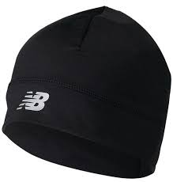
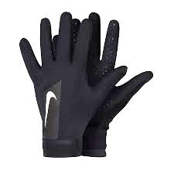
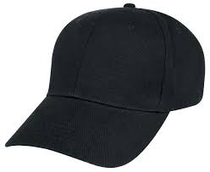
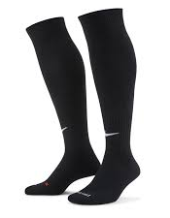
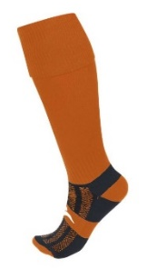
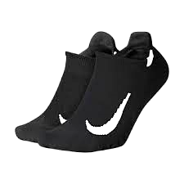
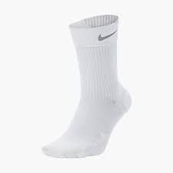
PE KIT – Guide to purchasing & policy
Hats & gloves- Beanie hats and sports gloves can be worn when the weather is cold, but the PE staff decide when it’s appropriate for them to be worn. In the summer baseball caps can be worn.
Socks – Orange or black long socks should be worn in the autumn, winter and spring terms. In the summer term and in indoor lessons ankle socks or normal length socks of any colour should be worn.
Beanie hat
Sports gloves
Baseball cap
Black knee
length socks
Orange knee
length socks
Ankle socks
normal
PE Kit Policy
Ill or injured students
If students are ill or injured they must bring a note, and bring their PE kit and wear it. Students will not take part practically in the lessons, but will help out in other roles. The only exceptions to this rule is if the student is unable to get changed due to having a cast on, or it has just been removed, or they have a bad back or neck.
Lost PE Kit
If the student has lost their PE kit, they are required to bring an alternative kit and a note from home explaining about their kit.
Forgotten kit
If the student forgets their PE kit they get a kit mark which is a warning (C2). If they forget their kit again they will receive a 1 hour after school detention (C3), and this will be the same sanction every time they forget their kit after that. These correctives run from September to July and are not reset every term.
Jewellery
Jewellery should be removed to avoid injury to the student and others. Sports watches should only be worn during fitness, cross country and athletics lessons.
Valuables
Valuables e.g. wallets, purses, watches and phones should be handed into the PE staff where they will be placed in the PE office. Students must not leave their valuables in the changing rooms as we cannot guarantee they will always be locked due to a number of reasons.

